Slide 2
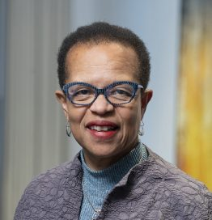
Making Sense of Uncertainty: Nonprofit Scenario Planning in an Election Year
September 18, 2024
11:45am – 12:45pm
Laura Lanzerotti
Willa Seldon
Partner,
The Bridgespan Group (San Francisco)
Partner,
The Bridgespan Group
(San Francisco)
@BridgespanGroup
@BridgespanGroup

Slide 3
About The Bridgespan Group
overall_1_132080351076114047 columns_3_132080351075985255
Our Services
Developing & Sharing Insights
The Bridgespan Group is a global nonprofit organization that collaborates with mission-driven leaders, organizations, and philanthropists, to make the world more equitable and just.
Philanthropy
Consulting
Leadership
Development
Nonprofit & NGO
Strategy Consulting

Slide 4
Our goals for today
overall_0_132300490715482287 columns_1_132291312101978277 4_1_132291312300874868 5_1_132300491364960371 8_1_132300490455746895 11_1_132300491383820132 14_1_132300491401596195 25_1_132307397407243695 34_1_132307397431098772
Share strategies and tactics for scenario planning this election year
Help you begin to apply these tools as a leader of your organization
@BridgespanGroup

Slide 5
What are you hoping to get out of this session? What’s top of mind for your organization related to the upcoming election?
@BridgespanGroup

Slide 6
Things you might feel or hear about scenario planning
We can’t predict the future. It’s not worth doing
“
It’s too complex, and we don’t have the time to do it
It’s too painful. I can’t deal with thinking about the possibility of [X] future happening
“
“

Slide 7
Now is a good time to clarify guiding principles for decision-making
Categories of principles
Examples of guiding principles
Protect the mission
We will find ways to safely and effectively continue our core programs
We will prioritize activities where there is greatest need in the communities we serve
Put people first
We will prioritize the well-being of our people
We are invested in the long-term careers of our team members
Elevate equity
We will use equity as a lens for all decision making related to the people we employ
We will prioritize people of color when weighing programmatic or operational shifts
Focus on financial
sustainability
We will aggressively protect revenue streams before cutting critical expenses
We will preserve the long-term financial health of our organization
Source: A Compass for the Crisis: Nonprofit Decision Making in the COVID-19 Pandemic, Lindsey Waldron and Preeta Nayak, Bridgespan.org

Slide 8
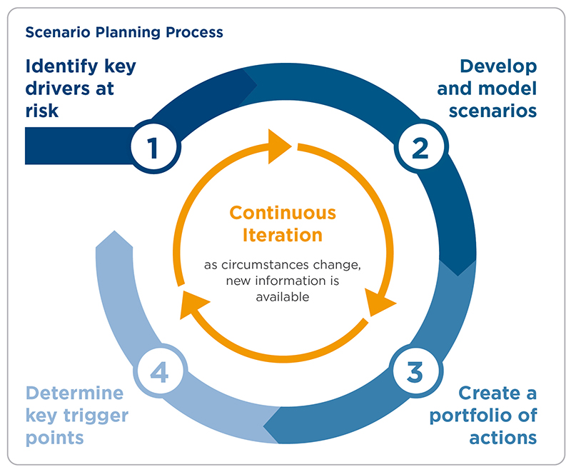
Scenario planning is a way to navigate uncertainty and provide structure around making key strategic choices
overall_0_132313425406187664 columns_1_131932671858153565 33_1_132313425350784274 6_1_132488961982730255
Identify impacted areas
Describe potential impacts
0
Develop scenarios
Determine key trigger points
Create a portfolio of actions
Source: The Bridgespan Group

Slide 9
Step 0: Develop scenarios
DEMOCRATIC TRIFECTA
DIVIDED GOVERNMENT
Democratic White House
1A
2B
DIVIDED GOVERNMENT
1B
2A
REPUBLICAN TRIFECTA
TIP: Focus on a few distinct, plausible scenarios; avoid overcomplicating
Republican White House
Democratic House/Senate
Republican House/Senate
@BridgespanGroup

Slide 10
Step 0: Develop scenarios
DEMOCRATIC TRIFECTA
DIVIDED GOVERNMENT
Additional potential factors to consider
Could drive swift legislative action on progressive priorities, climate and healthcare reforms, secure judicial appointments, and implement social policies
Could lead to legislative gridlock, with the president relying on executive orders and vetoes, increased scrutiny, and resisting of nominee confirmations. Efforts at
Civil unrest or political violence
Results of local and state elections
Other?
Democratic White House
bipartisanship might center on issue like infrastructure or criminal justice reform
1A
2B
DIVIDED GOVERNMENT
1B
2A
REPUBLICAN TRIFECTA
Would likely see heightened partisan conflict, with the president relying on executive orders and vetoes to push conservative policies, including reversal of some Biden administration’s policy priorities
May lead to aggressive pursuit of conservative priorities focusing on dismantling Federal government infrastructure and Democrat initiated policies, and enacting Trump’s key initiatives
Republican White House
Democratic House/Senate
Republican House/Senate
@BridgespanGroup
Source: Adapted from Freedman Consulting, “Scenario Mapping & Philanthropic Levers for Impact: Planning for 2025;” Bridgespan analysis

Slide 11
STEP 1: Identify Impacted Areas
1
IDENTIFY IMPACTED AREAS
Describe potential impacts
Create portfolio of actions
Determine key trigger points
What aspects of your organization might be most affected by the election outcome(s)?
PROGRAMS
OPERATIONS
FUNDING
TIP:
Don’t get distracted by small stuff as you consider both potential risks and opportunities

Slide 12
Step 1 (cont.): Use diagnostic to identify areas of greatest potential impact
 |  | FOR THIS SCENARIO…. | For Scenario 1: Demographic Trifecta
 |  | Significant impact? | Better than current | Neutral | Watch-out | Major implications
STRATEGY / PROGRAMS | 1. CHANGING NEEDS OF THOSE YOUR ORGANIZATION EXISTS TO SERVE: To what extent might communities or populations you work with be differentially impacted? | Y
 | 2. STRATEGY/PROGRAMMATIC APPROACH: Are there parts of your work (e.g., direct service, policy/advocacy, technical assistance) for which the strategy/approach/goals may have to significantly shift? | Y
 | 3. RESTRICTIONS IN DOING THE WORK: Does the field (e.g., reproductive health, racial equity, LGBTQ) you work in face potential policy impacts that may create restrictions to how/where your organization can work?
 | 4. EXTERNAL PARTNERS: Would the outcome of the election fundamentally impact those your partner with and/or who the people you serve rely upon?
OPERATIONS | 5. PROTECTING CORE OPERATIONS: To what extent might different election outcomes significantly impact the ability of your organization to maintain its core operations? | Y
Operations | 6. DIFFERENTIALLY IMPACTED STAFF: Are there individuals on your team that might be differentially impacted by election outcomes that will need additional support?
 | 7. MANAGING LEADERSHIP AND ORGANIZATIONAL CAPACITY: Would different election outcomes differentially draw down on leadership time needed for planning and executing shifts?
FINANCIAL | 8. GOVERNMENT FUNDING: How reliant is your organization on public funding, and to what extent could the election outcome impact public funding available?
Financial | 9. PHILANTHROPIC FUNDING: How concentrated are your sources of philanthropic funding, and to what extent might these be impacted by the election outcome?
 | 10. EARNED REVENUE: If your organization has significant earned revenue, to what extent could the election outcome impact either demand or ability/willingness to pay for your services?

Slide 13
Pair up with a table partner
1
Open an envelope and read the enclosed scenario
Discuss
What’s your reaction?
What do you imagine might be the reaction of your staff and/or the communities you serve?
What aspects of your organization might be most impacted? (Here’s where we hope the diagnostic tool will be helpful.)
2

Slide 14
Scenarios

Slide 15
CURRENT COUNT
HOUSE
SENATE
220
51
215
49
> BREAKING NEWS
L I VE
DONALD TRUMP CELEBRATES VICTORY IN 2024 PRESIDENTIAL ELECTION

Slide 16
Trump-Vance Victory
Illustrative
FOR THE SECOND TIME, TRUMP WINS A VICTORY IN THE ELECTORAL COLLEGE, BUT LOSES THE POPULAR VOTE
Large-scale protests erupt across the country opposing Trump’s victory. These protests, fueled by allegations of election fraud, voter suppression, and fears of authoritarianism, are met with equally large counter-protests by Trump supporters, leading to violent clashes
Social media and conservative news organizations amplifies this division, spreading misinformation and conspiracy theories that deepen mistrust and hostility
Trump has already announced that he will appoint a special prosecutor to investigate former president Joe Biden
ACROSS THE SOCIAL SECTOR, CIVIL LIBERTIES ARE UNDER PRESSURE AND NON-PROFIT ORGANIZATIONS AND PHILANTHROPY FACE THREATS
Protest groups and activists opposing Trump’s administration encounter increased surveillance and legal challenges
Non-profit organizations critical of Trump risk losing their c3 status, leading to reduced funding and operational difficulties
Trump has announced cuts to healthcare programs like Medicaid and the Affordable Care Act² , significant cuts to federal agencies focused on education and climate; programs promoting diversity, equity, and inclusion face defunding
Right-wing media and Trump loyalists are encouraged to target and intimidate activists, creating a hostile environment for social justice work
IN THE EARLY DAYS OF HIS ADMINISTRATION, PRESIDENT TRUMP BEGAN EXECUTING ON HIS CAMPAIGN PRIORITIES THROUGH EXECUTIVE ORDERS AND OTHER ADMINISTRATIVE ACTIONS, INCLUDING:
Reclassification of federal employees as at-will workers, leading to a purge of non-partisan professionals and the installation of Trump loyalists in key positions¹
Reinstatement of immigration policies including travel bans and deportations, heightening fear and insecurity among immigrant communities²
Aggressive roll backs of environmental protections, termination of green energy efforts, favoring oil drilling and mining²
Additional tax cuts, including reduction of corporate tax rate, extension of the 2017 Tax Cuts
Pardons for Jan 6. rioters and other key supporters, appointment of conservative judges and U.S. attorneys³
Revoke Biden’s equity executive order that required federal agencies to deliver equitable outcomes in policy and conduct equity training³
Source: 1. Project 2025 Recap on KamalaHarris.com 2. Trump Administration Civil and Human Rights Rollbacks 3. CNN: Trump Campaign Promises

Slide 17
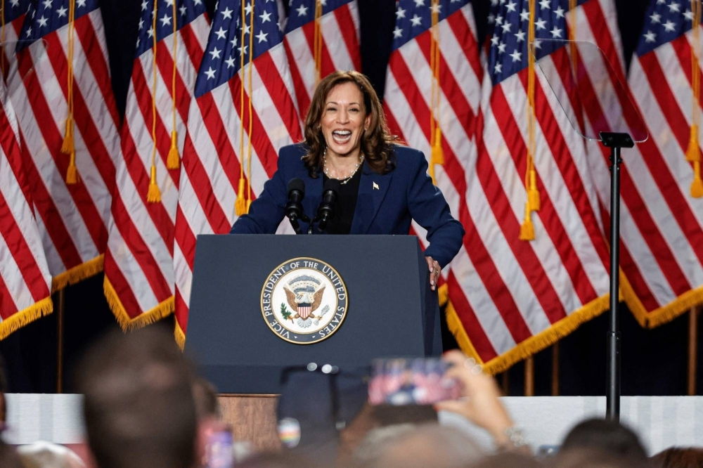
CURRENT COUNT
HOUSE
SENATE
215
51
220
49
> BREAKING NEWS
VICE PRESIDENT KAMALA HARRIS WINS PRESIDENCY IN CLOSE RACE
L I VE

Slide 18
Harris-Walz Victory
Illustrative
KAMALA HARRIS’S 2024 VICTORY HAS LED TO SIGNIFICANT CELEBRATION AND CHAOS ACROSS THE COUNTRY
Kamala Harris breaks barriers as the first President who is female and of South Asian and African American descent
Whispers of election integrity and legitimacy resurface, fueling a debate about the legitimacy of Harris's presidency. Trump has refused to concede, calling the election insurrectionary
ACROSS THE SOCIAL SECTOR, NON-PROFIT ORGANIZATIONS RECEIVE ADDITIONAL FUNDING AND POLICY SUPPORT, BUT ALSO FACE ADDITIONAL SCRUTINY AND OPPOSITION
Harris’s administration announced increase funding for social programs focused on healthcare, education, and housing
Diversity, equity, and inclusion initiatives are reinstated and build strong defenses against increasing legal attacks
Republicans in the House and Senate launch aggressive investigations into the activities of progressive c3 and c4 organizations
IN THE EARLY DAYS OF THE HARRIS ADMINISTRATION, PRESIDENT HARRIS SIGNALED HER PRIORITIES IN EXECUTIVE ORDERS AND A VARIETY OF ADMINISTRATIVE ACTIONS, AND MOVES TO ADVANCE OTHER CAMPAIGN PRIORITIES INCLUDING:
Expansion of the Affordable Care Act (ACA) by increasing subsidies for health insurance and acceleration of Medicare’s drug price negotiations¹
Call for the first-ever federal ban on price gouging on food and groceries, securing new authority for the Federal Trade Commission and state attorneys general to investigate and penalize companies that unfairly exploit consumers in the quest for excessive profits¹
Specific targets for reducing US climate pollution by 2035 as per the Paris climate agreement¹
Cancellation of medical debt as well as federal student loan debt, targeting those with the greatest financial need¹
Introduction of legislation that codifies abortion rights and invalidates state bans and restrictions, but that also ends discriminatory barriers to abortion care, such as insurance coverage bans²
Implementation of national standards for use-of-force policies, including requirements for de-escalation training and increased transparency in police investigations³
Source: 1. CNN: Kamala Harris Campaign Promises 2. ACLU: How Kamala Harris can secure federal abortion protection once and for all 3. Biden 2022 EO on Public Safety

Slide 19
Diagnostic: Identify areas of greatest potential impact
 |  | FOR THIS SCENARIO [X]…. | For Scenario 1: Demographic Trifecta
 |  | Significant impact? | Better than current | Neutral | Watch-out | Major implications
STRATEGY / PROGRAMS | 1. CHANGING NEEDS OF THOSE YOUR ORGANIZATION EXISTS TO SERVE: To what extent might communities or populations you work with be differentially impacted?
 | 2. STRATEGY/PROGRAMMATIC APPROACH: Are there parts of your work (e.g., direct service, policy/advocacy, technical assistance) for which the strategy/approach/goals may have to significantly shift?
 | 3. RESTRICTIONS IN DOING THE WORK: Does the field (e.g., reproductive health, racial equity, LGBTQ) you work in face potential policy impacts that may create restrictions to how/where your organization can work?
 | 4. EXTERNAL PARTNERS: Would the outcome of the election fundamentally impact those your partner with and/or who the people you serve rely upon?
OPERATIONS | 5. PROTECTING CORE OPERATIONS: To what extent might different election outcomes significantly impact the ability of your organization to maintain its core operations?
Operations | 6. DIFFERENTIALLY IMPACTED STAFF: Are there individuals on your team that might be differentially impacted by election outcomes that will need additional support?
 | 7. MANAGING LEADERSHIP AND ORGANIZATIONAL CAPACITY: Would different election outcomes differentially draw down on leadership time needed for planning and executing shifts?
FINANCIAL | 8. GOVERNMENT FUNDING: How reliant is your organization on public funding, and to what extent could the election outcome impact public funding available?
Financial | 9. PHILANTHROPIC FUNDING: How concentrated are your sources of philanthropic funding, and to what extent might these be impacted by the election outcome?
 | 10. EARNED REVENUE: If your organization has significant earned revenue, to what extent could the election outcome impact either demand or ability/willingness to pay for your services?

Slide 20
STEP 2: Describe Potential Impacts
2
Identify impacted areas
DESCRIBE POTENTIAL IMPACTS
Create portfolio of actions
Determine key trigger points
Consider both the short- and longer-term impacts for your organization, for example:
Programs & services: What might be the potential impact on the communities you serve? What new needs might there be? What restrictions might you face in terms of how you do your work?
Operations: Who on your team might be most impacted, and how might they be impacted?
Funding: What might be the impact on the different sources of revenue you rely on (government, philanthropy)?
TIP:
Precision isn’t the goal; leverage experience from previous crises

Slide 21
STEP 3: Create Portfolio of Actions
3
Identify impacted areas
Describe potential impacts
CREATE PORTFOLIO OF ACTIONS
Determine key trigger points
Appropriate for any scenario
“No regrets” actions with protective and positive benefits under any scenario
Make sure you have emergency plans in place; reach out to key partners
Smaller-scale and flexible
Actions that can be executed quickly and reversed, if needed, as circumstances change
Temporarily increase supports or flexibility for staff (e.g., remote work)
Larger and more permanent
Actions that reflect significant investments, cost reductions or operational changes
Open or close a program site, or revise a strategy, based on political or funding changes

Slide 22
STEP 4: Determine key trigger points
4
Identify impacted areas
Assess potential impacts
Create portfolio of actions
DETERMINE KEY TRIGGER POINTS
Trigger point could be an EVENT
If X happens on election day, we’ll send a communication to all staff and key partners
TIP:
Establish (or update) your decision processes and roles so that you’re ready to act when needed
Trigger point could be a DATE
By X date, we’ll need to decide whether to cancel or shift the agenda for a convening we have scheduled

Slide 23
Getting started!
overall_1_132465129339579067 columns_1_132465129339579067 4_1_132465570463604600
Access Bridgespan’s new article and scenario planning toolkit
Consider asking key partners or allies in other organizations to brainstorm with you, and/or engage your senior team and Board
Identify the most important risks and / or opportunities facing your organization
Identify the set of “no regrets” moves that you want to be ready to make, regardless of the election outcome(s)

Slide 24
overall_0_132890683543515110 columns_1_132890673013020096
Stay Connected:
Publications@Bridgespan.org
Bspan.org/leadersmatter
@BridgespanGroup

Slide 25
overall_0_132890683543515110 columns_1_132890673013020096
LAURA LANZEROTTI
Partner
The Bridgespan Group
Laura.Lanzerotti@bridgespan.org
WILLA SELDON
Partner
The Bridgespan Group
Willa.Seldon@bridgespan.org

